Slide 1
UNIT-VI
Parallel Organization
Notes:
<number>

Slide 2
Syllabus Contents
Parallel Organization – Multiprocessors, Multicores & Clusters.
Flynn’s Taxonomy for Multiple Processor Organizations,
Closely and Loosely Coupled Multiprocessors Systems,
Symmetric Multiprocessor (SMP) Organization,
Multithreading – Fine Grained, Coarse Grained & Simultaneous (SMT) Threading, Chip Multiprocessing,
Cluster Configuration, UMA, NUMA & CC-NUMA.
Multicore Architectures – Hardware & Software Issues in Multicore Organization,
Multicore Organizations, Intel X86 Multicore Organizations – Core Duo & Core i7.

Slide 3
parallel organization
Notes:
<number>

Slide 4
Multiple Processor Organization
Types of Parallel Processor Systems:-
A taxonomy first introduced by Flynn
Single instruction, single data stream - SISD
Single instruction, multiple data stream - SIMD
Multiple instruction, single data stream - MISD
Multiple instruction, multiple data stream- MIMD
Notes:
<number>

Slide 5
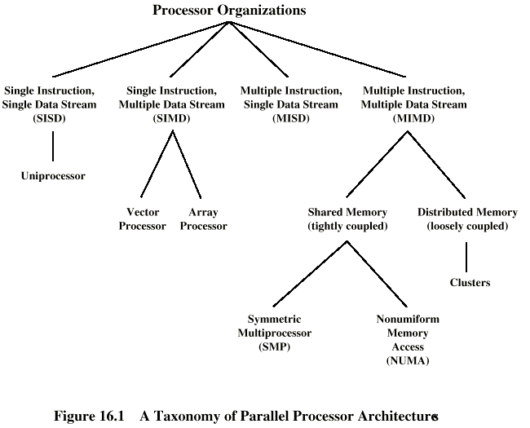
Taxonomy of Parallel Processor Architectures

Slide 6
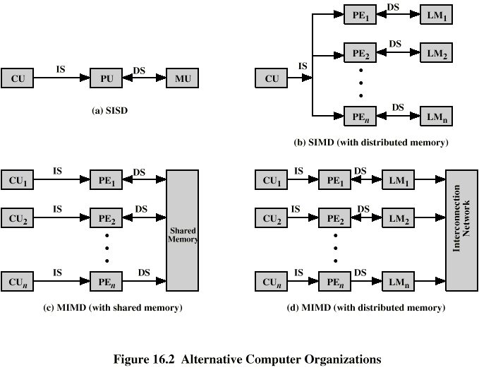
Single Instruction, Single Data Stream - SISD
Single processor
Single instruction stream
Data stored in single memory
E.g. Uni-processor
CU: Control unit
IS: Instruction stream
PU: Processing unit
DS: Data stream
MU: Memory unit
LM: Local memory
Notes:
<number>

Slide 7
Single Instruction, Multiple Data Stream - SIMD
Single machine instruction
Controls simultaneous execution
Number of processing elements
Lockstep basis
Each processing element has associated data memory
Each instruction executed on different set of data by different processors
E.g. Vector and array processors
Notes:
<number>

Slide 8
Single Instruction, Multiple Data Stream - SIMD (cont..)
SIMD with distributed memory

Slide 9
Multiple Instruction, Single Data Stream - MISD
Sequence of data
Transmitted to set of processors
Each processor executes different instruction sequence
Never been implemented
Notes:
<number>

Slide 10
Multiple Instruction, Multiple Data Stream- MIMD
Set of processors
Simultaneously execute different instruction sequences
Different sets of data
E.g. SMPs (Symmetric Multiprocessors), clusters and NUMA (NonUniform Memory Access) systems
Notes:
<number>

Slide 11
MIMD - Overview
General purpose processors
Each can process all instructions necessary to perform the appropriate data transformation
Further classified by method of processor communication:
Tightly/Closely coupled: SMP, NUMA
Loosely coupled: Clusters
Notes:
<number>

Slide 12
Tightly Coupled - SMP
Processors share memory
Communicate via that shared memory
Symmetric Multiprocessor (SMP)
Share single memory or pool
Shared bus to access memory
Memory access time to given area of memory is approximately the same for each processor
Notes:
<number>

Slide 13
Tightly Coupled - NUMA
Nonuniform memory access
Access times to different regions of memroy may differ
Notes:
<number>

Slide 14
Loosely Coupled - Clusters
Collection of independent uniprocessors or SMPs
Interconnected to form a cluster
Communication via fixed path or network connections
Notes:
<number>

Slide 15
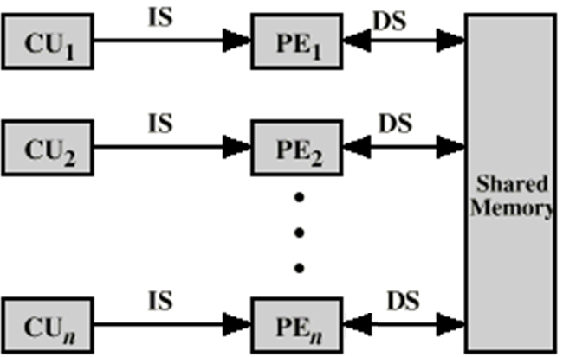
MIMD with Shared Memory
Notes:
<number>

Slide 16
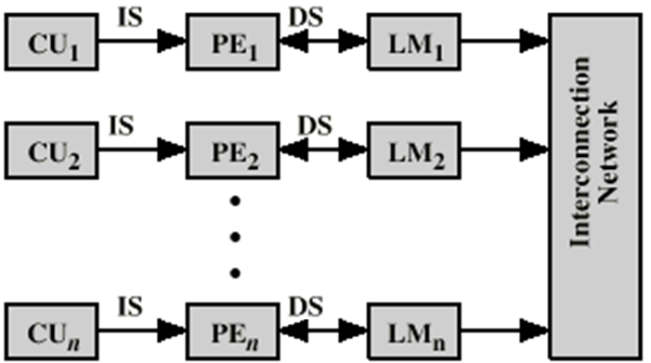
MIMD with Distributed Memory
Notes:
<number>

Slide 17
Symmetric Multiprocessor organization
Notes:
<number>

Slide 18
Symmetric Multiprocessors
A stand alone computer with the following characteristics
Two or more similar processors of comparable capacity
Processors share same memory and I/O
Processors are connected by a bus or other internal connection
Memory access time is approximately the same for each processor
All processors share access to I/O
Either through same channels or different channels giving paths to same devices
All processors can perform the same functions (hence symmetric)
System controlled by integrated operating system
providing interaction between processors
Interaction at job, task, file and data element levels
Notes:
<number>

Slide 19
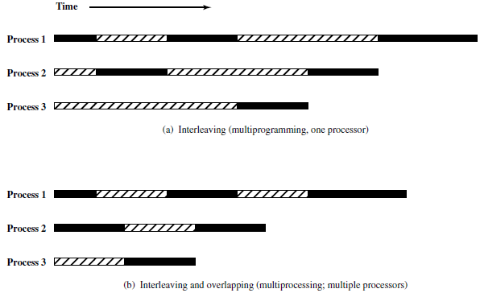
Multiprogramming and Multiprocessing

Slide 20
SMP Advantages
Performance
If some work can be done in parallel
Availability
Since all processors can perform the same functions, failure of a single processor does not halt the system
Incremental growth
User can enhance performance by adding additional processors
Scaling
Vendors can offer range of products based on number of processors
Notes:
<number>

Slide 21
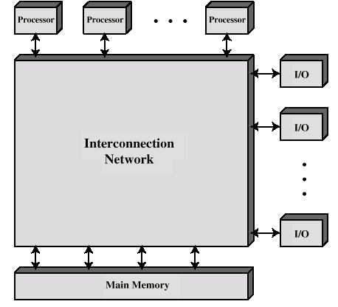
Block Diagram of Tightly Coupled Multiprocessor
Notes:
<number>

Slide 22
Organization Classification
Time shared or common bus
Multiport memory
Central control unit
Notes:
<number>

Slide 23
Time Shared Bus
Simplest form
Structure and interface similar to single processor system
Following features provided
Addressing - distinguish modules on bus
Arbitration - any module can be temporary master
Time sharing - if one module has the bus, others must wait and may have to suspend
Now have multiple processors as well as multiple I/O modules
Notes:
<number>

Slide 24
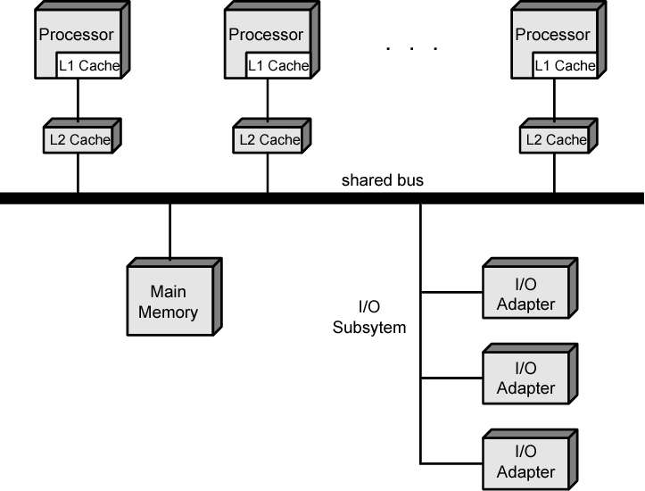
Symmetric Multiprocessor Organization

Slide 25
Time Share Bus (cont..)
Advantages:
Simplicity
Flexibility
Reliability
Disadvantages:
Performance limited by bus cycle time
Each processor should have local cache
Reduce number of bus accesses
Leads to problems with cache coherence
Solved in hardware
Notes:
<number>

Slide 26
Operating System Issues
Simultaneous concurrent processes
Scheduling
Synchronization
Memory management
Reliability and fault tolerance
Notes:
<number>

Slide 27
Multithreading & Chip Multiprocessors
Notes:
<number>

Slide 28
Multithreading and Chip Multiprocessors
Instruction stream divided into smaller streams (threads)
Executed in parallel
Wide variety of multithreading designs

Slide 29
Definitions of Threads and Processes
Thread in multithreaded processors may or may not be same as software threads
Process:
An instance of program running on computer
Resource ownership
Virtual address space to hold process image
Scheduling/execution
Process switch
Thread: dispatchable unit of work within process
Includes processor context (which includes the program counter and stack pointer) and data area for stack
Thread executes sequentially
Interruptible: processor can turn to another thread
Thread switch
Switching processor between threads within same process
Typically less costly than process switch

Slide 30
Implicit and Explicit Multithreading
All commercial processors and most experimental ones use explicit multithreading
Concurrently execute instructions from different explicit threads
Interleave instructions from different threads on shared pipelines or parallel execution on parallel pipelines
Implicit multithreading is concurrent execution of multiple threads extracted from single sequential program
Implicit threads defined statically by compiler or dynamically by hardware

Slide 31
Approaches to Explicit Multithreading
Interleaved
Fine-grained
Processor deals with two or more thread contexts at a time
Switching thread at each clock cycle
If thread is blocked it is skipped
Blocked
Coarse-grained
Thread executed until event causes delay
E.g.Cache miss
Effective on in-order processor
Avoids pipeline stall
Simultaneous (SMT)
Instructions simultaneously issued from multiple threads to execution units of superscalar processor
Chip multiprocessing
Processor is replicated on a single chip
Each processor handles separate threads

Slide 32
Scalar Processor Approaches
Single-threaded scalar
Simple pipeline
No multithreading
Interleaved multithreaded scalar
Easiest multithreading to implement
Switch threads at each clock cycle
Pipeline stages kept close to fully occupied
Hardware needs to switch thread context between cycles
Blocked multithreaded scalar
Thread executed until latency event occurs
Would stop pipeline
Processor switches to another thread

Slide 33
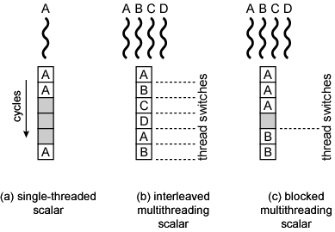
Scalar Diagrams

Slide 34
clusters
Notes:
<number>

Slide 35
Clusters
Alternative to SMP
High performance
High availability
Server applications
A group of interconnected whole computers
Working together as unified resource
Illusion of being one machine
Each computer called a node
Notes:
<number>

Slide 36
Cluster Benefits
Absolute scalability
Incremental scalability
High availability
Superior price/performance
Notes:
<number>

Slide 37
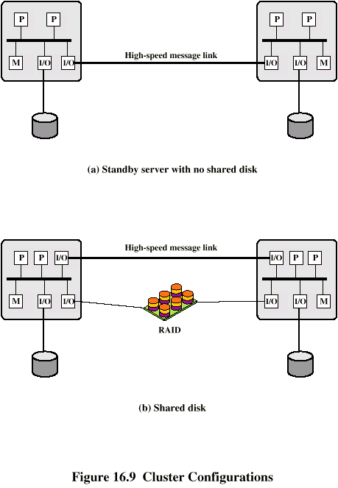
Cluster Configurations - Standby Server, No Shared Disk
Notes:
<number>

Slide 38
Cluster Configurations - Shared Disk
Notes:
<number>

Slide 39
Operating Systems Design Issues
Failure Management
High availability
Fault tolerant
Failover
Switching applications & data from failed system to alternative within cluster
Failback
Restoration of applications and data to original system after problem is fixed
Load balancing
Incremental scalability
Automatically include new computers in scheduling
Middleware needs to recognise that processes may switch between machines

Slide 40
Parallelizing
Single application executing in parallel on a number of machines in cluster
Complier
Determines at compile time which parts can be executed in parallel
Split off for different computers
Application
Application written from scratch to be parallel
Message passing to move data between nodes
Hard to program
Best end result
Parametric computing
If a problem is repeated execution of algorithm on different sets of data
e.g. simulation using different scenarios
Needs effective tools to organize and run

Slide 41
Cluster Vs SMP
Both provide multiprocessor support to high demand applications.
Both available commercially
SMP for longer
SMP:
Easier to manage and control
Closer to single processor systems
Scheduling is main difference
Less physical space
Lower power consumption
Clustering:
Superior incremental & absolute scalability
Superior availability
Redundancy

Slide 42
uMA, NUMA,CC-NUMA
Notes:
<number>

Slide 43
NonUniform Memory Access (NUMA)
Alternative to SMP & clustering
Uniform Memory Access (UMA)
All processors have access to all parts of memory
Using load & store
Access time to all regions of memory is the same
Access time to memory for different processors same
As used by SMP
NonUniform Memory Access(NUMA)
All processors have access to all parts of memory
Using load & store
Access time of processor differs depending on region of memory
Different processors access different regions of memory at different speeds
Cache Coherent NUMA(CC-NUMA)
Cache coherence is maintained among the caches of the various processors
Significantly different from SMP and clusters

Slide 44
Motivation
SMP has practical limit to number of processors
Bus traffic limits to between 16 and 64 processors
In clusters each node has own memory
Apps do not see large global memory
Coherence maintained by software not hardware
NUMA retains SMP flavour while giving large scale multiprocessing
e.g. Silicon Graphics Origin NUMA 1024 MIPS R10000 processors
Objective is to maintain transparent system wide memory while permitting multiprocessor nodes, each with own bus or internal interconnection system

Slide 45
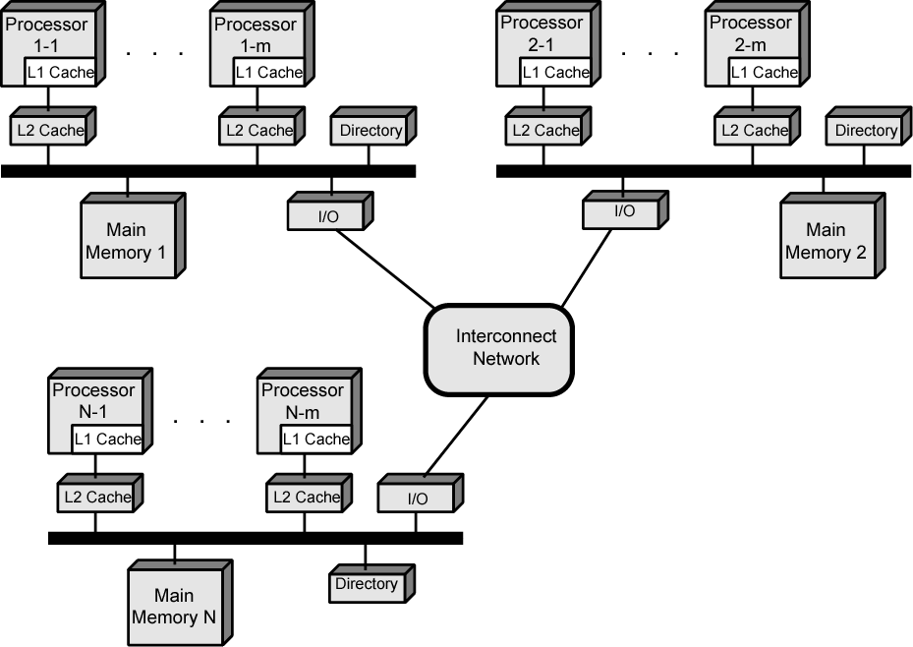
CC-NUMA Organization

Slide 46
CC-NUMA Operation
Each processor has own L1 and L2 cache
Each node has own main memory
Nodes connected by some networking facility
Each processor sees single addressable memory space
Memory request order:
L1 cache (local to processor)
L2 cache (local to processor)
Main memory (local to node)
Remote memory
Delivered to requesting (local to processor) cache
Automatic and transparent

Slide 47
Memory Access Sequence
Each node maintains directory of location of portions of memory and cache status
e.g. node 2 processor 3 (P2-3) requests location 798 which is in memory of node 1
P2-3 issues read request on snoopy bus of node 2
Directory on node 2 recognises location is on node 1
Node 2 directory requests node 1’s directory
Node 1 directory requests contents of 798
Node 1 memory puts data on (node 1 local) bus
Node 1 directory gets data from (node 1 local) bus
Data transferred to node 2’s directory
Node 2 directory puts data on (node 2 local) bus
Data picked up, put in P2-3’s cache and delivered to processor

Slide 48
Cache Coherence
Node 1 directory keeps note that node 2 has copy of data
If data modified in cache, this is broadcast to other nodes
Local directories monitor and purge local cache if necessary
Local directory monitors changes to local data in remote caches and marks memory invalid until writeback
Local directory forces writeback if memory location requested by another processor

Slide 49
NUMA Pros & Cons
Effective performance at higher levels of parallelism than SMP
No major software changes
Performance can breakdown if too much access to remote memory
Can be avoided by:
L1 & L2 cache design reducing all memory access
Need good temporal locality of software
Good spatial locality of software
Virtual memory management moving pages to nodes that are using them most
Not transparent
Page allocation, process allocation and load balancing changes needed

Slide 50
multicore architectures
Notes:
<number>

Slide 51
Hardware Performance Issues
Microprocessors have seen an exponential increase in performance
Improved organization
Increased clock frequency
Increase in Parallelism
Pipelining
Superscalar
Simultaneous multithreading (SMT)
Diminishing returns
More complexity requires more logic
Increasing chip area for coordinating and signal transfer logic
Harder to design, make and debug

Slide 52
Software Performance Issues
Performance benefits dependent on effective exploitation of parallel resources
Even small amounts of serial code impact performance
10% inherently serial on 8 processor system gives only 4.7 times performance
Communication, distribution of work and cache coherence overheads
Some applications effectively exploit multicore processors

Slide 53
Effective Applications for Multicore Processors
Database
Servers handling independent transactions
Multi-threaded native applications
Lotus Domino, Siebel CRM
Multi-process applications
Oracle, SAP, PeopleSoft
Java applications
Java VM is multi-thread with scheduling and memory management
Sun’s Java Application Server, BEA’s Weblogic, IBM Websphere, Tomcat
Multi-instance applications
One application running multiple times
E.g. Value Game Software

Slide 54
Multicore Organization
Number of core processors on chip
Number of levels of cache on chip
Amount of shared cache
E.g. of multicore organization:
(a) ARM11 MPCore
(b) AMD Opteron
(c) Intel Core Duo
(d) Intel Core i7

Slide 55
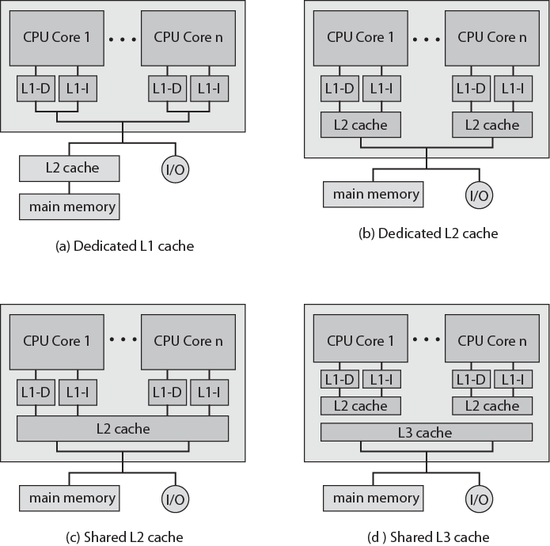
Multicore Organization Alternatives

Slide 56
Advantages of shared L2 Cache
Constructive interference reduces overall miss rate
Data shared by multiple cores not replicated at cache level
With proper frame replacement algorithms mean amount of shared cache dedicated to each core is dynamic
Threads with less locality can have more cache
Easy inter-process communication through shared memory
Cache coherency confined to L1
Dedicated L2 cache gives each core more rapid access
Good for threads with strong locality
Shared L3 cache may also improve performance

Slide 57
Individual Core Architecture
Intel Core Duo uses superscalar cores
Intel Core i7 uses simultaneous multi-threading (SMT)
Scales up number of threads supported
4 SMT cores, each supporting 4 threads appears as 16 core

Slide 58
Intel x86 Multicore Organization - Core Duo (1)
2006
Two x86 superscalar, shared L2 cache
Dedicated L1 cache per core
32KB instruction and 32KB data
Thermal control unit per core
Manages chip heat dissipation
Maximize performance within constraints
Improved ergonomics
Advanced Programmable Interrupt Controlled (APIC)
Inter-process interrupts between cores
Routes interrupts to appropriate core
Includes timer so OS can interrupt core

Slide 59
Intel x86 Multicore Organization - Core Duo (2)
Power Management Logic
Monitors thermal conditions and CPU activity
Adjusts voltage and power consumption
Can switch individual logic subsystems
2MB shared L2 cache
Dynamic allocation
MESI support for L1 caches
Extended to support multiple Core Duo in SMP
L2 data shared between local cores or external
Bus interface

Slide 60
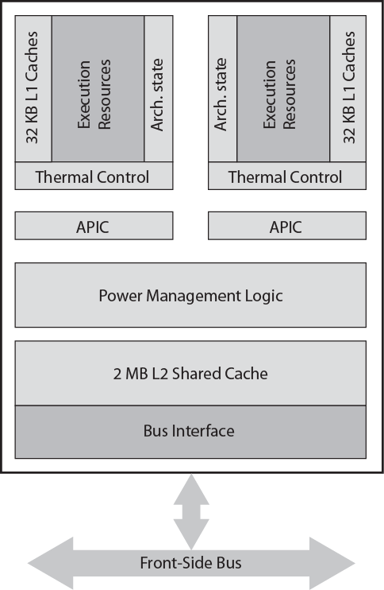
Intel Core Duo Block Diagram

Slide 61
Intel x86 Multicore Organization - Core i7
November 2008
Four x86 SMT processors
Dedicated L2, shared L3 cache
Speculative pre-fetch for caches
On chip DDR3 memory controller
Three 8 byte channels (192 bits) giving 32GB/s
No front side bus
QuickPath Interconnection
Cache coherent point-to-point link
High speed communications between processor chips
6.4G transfers per second, 16 bits per transfer
Dedicated bi-directional pairs
Total bandwidth 25.6GB/s

Slide 62
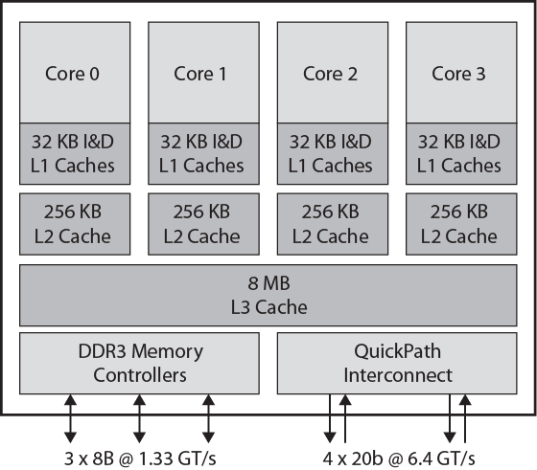
Intel Core i7 Block Diagram

Slide 63
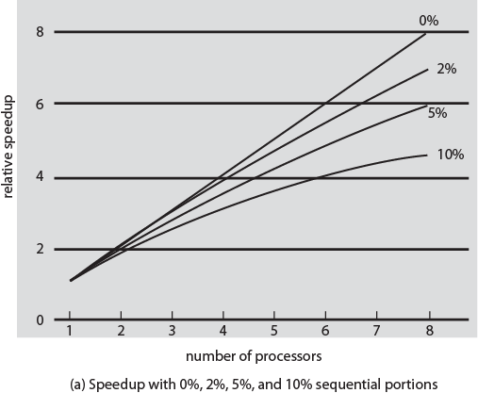
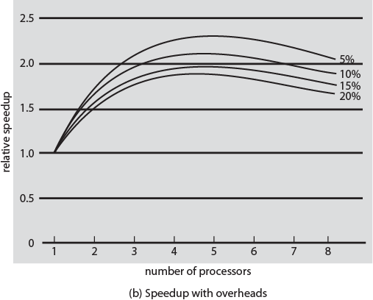
Performance Effect of Multiple Cores

